Slide 1
Empowering Customers: Why Microsoft Loves Linux

Slide 2
Our Open Source Strategy
Meet where customers are
Deliver the most productive and trustworthy cloud services platform that enables developers using any framework on any device or OS to create and power the world's apps and services that run anywhere
Best cloud platform for partners to succeed

Slide 3
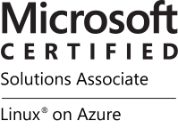
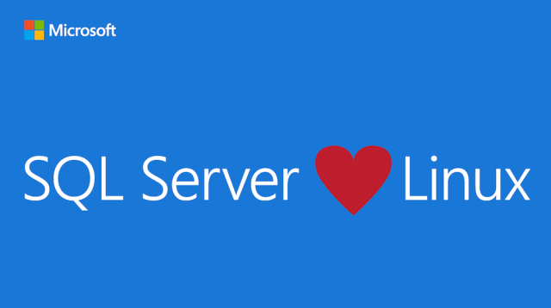
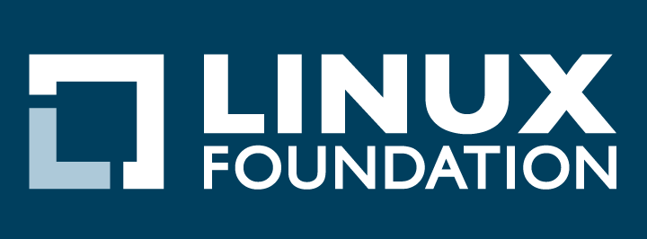


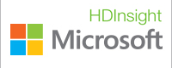


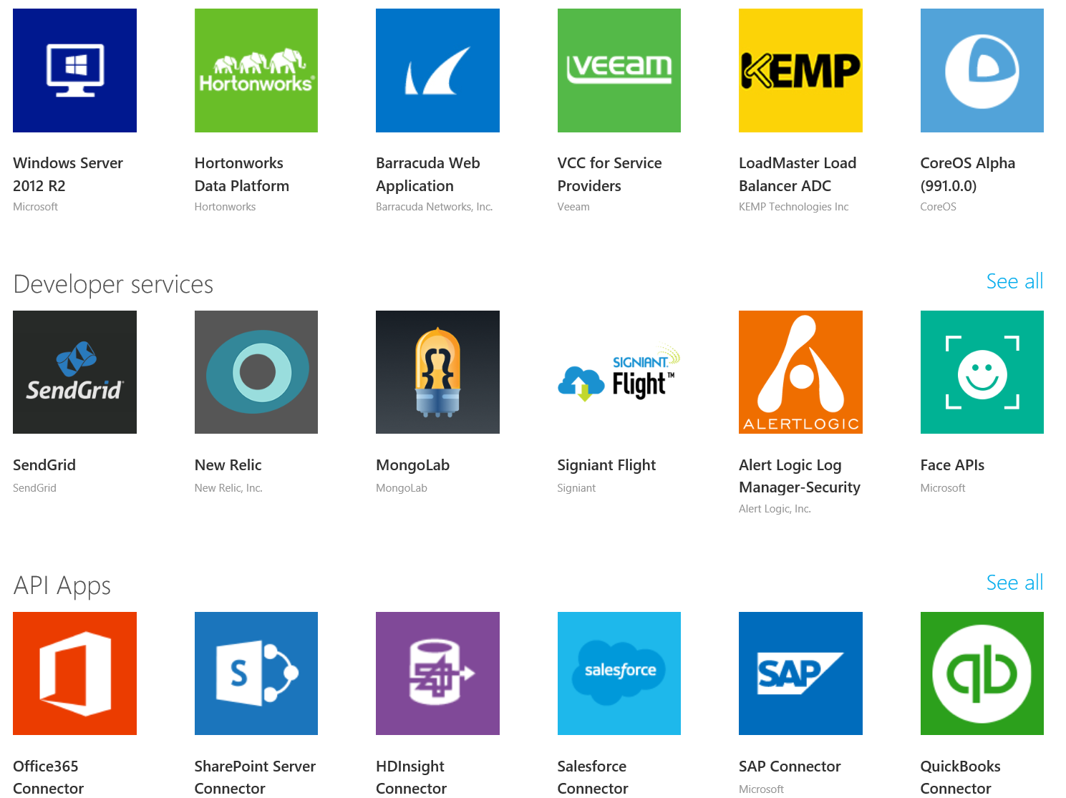
Momentum…
SQL Server on Linux
(Preview today, GA in mid-2017)
In partnership with the Linux Foundation, Microsoft releases the Microsoft Certified Solutions Associate (MCSA) Linux on Azure certification.
Red Hat - Microsoft Partnership
(Nov 2015)
Microsoft Employees
Ross Gardler: President Apache Software Foundation
Wim Coekaerts: Oracle’s Mr Linux
HD Insight PaaS on Linux GA (Sep 2015)
Microsoft joins Eclipse Foundation. (Eclipse is the largest OSS Dev Toolset)
(Mar 2016).
Azure Marketplace
60% of all images in Azure Marketplace are based on Linux/OSS
Windows Subsystem for Linux
Run Linux on Windows natively
(March 2016)
1 out of 4 VMs on Azure runs Linux, and getting larger every day
28.9% of All VMs are Linux
>50% of new VMs
1 out of 4 3
bash
467,484,471+
Lines Contributed
Open Source Hub

Slide 4
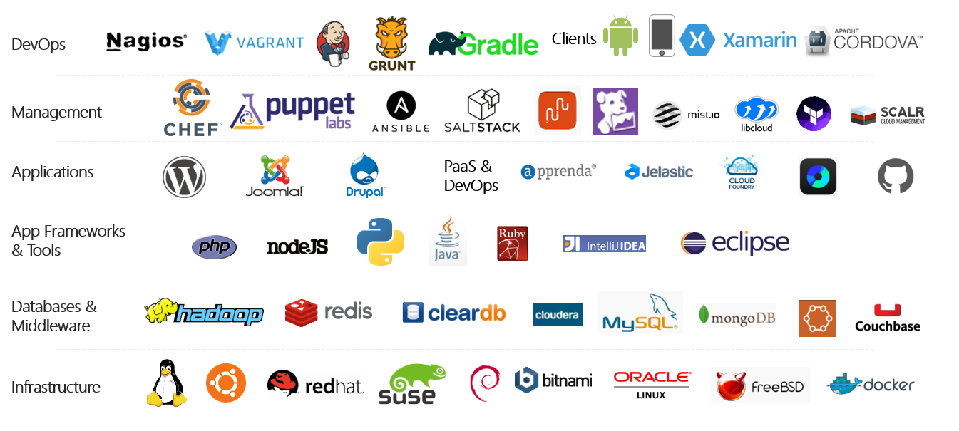
Azure is an open cloud
Notes:
P2

Slide 5

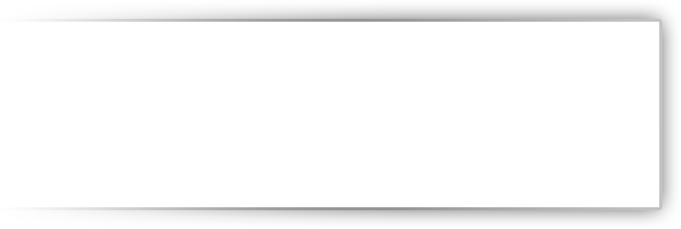

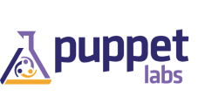
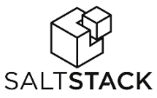







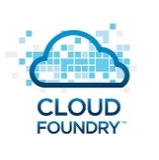
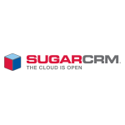



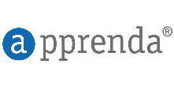
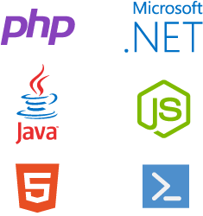








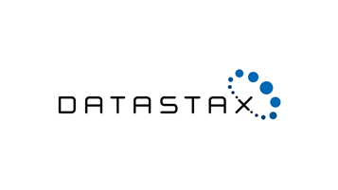
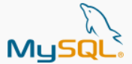

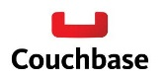
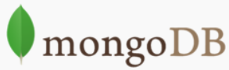
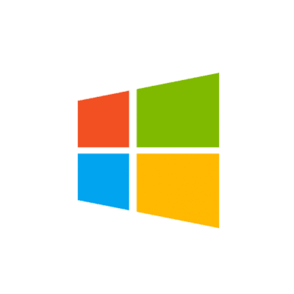





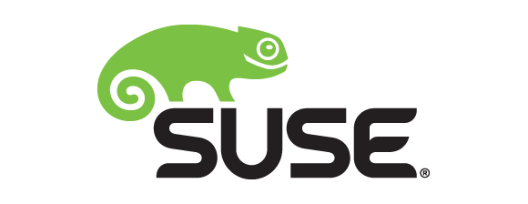

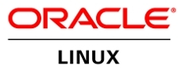
OLD partnership opportunity with Microsoft…..limited to our products
MS Product Centric
Management
System Center
Applications
Dynamics
SharePoint
Exchange
Application Frameworks
.NET
Databases
SQL Server
Infrastructure
Notes:
The reality is that in our industry, open source is pervasive. Just take a look at the technology stack – from the operating system up to the application, there are seemingly countless options in the open source space. Developers love open source, and the majority of those building new cloud based startups are also using open source technologies. Customers leverage it to be disruptive in their vertical, and our competitors are very effective in using it to capture share of wallet in the cloud.
Until now, we have successfully monetized a tight, vertically integrated family of technologies. But if we want a larger share of wallet in the cloud, it’s evident that we need to look beyond our only stack only and monetize open source technologies on Azure. By FY17 OSS is expected to represent an $18B opportunity in the IaaS and PaaS market. A large portion of private cloud and the majority of public cloud today is powered or influenced by open source.

Slide 6

New Era for Microsoft…..with New Partnership Whitespace
Public Cloud
Hybrid Cloud
Private Cloud
Our Cloud Opportunity $$$
Management
System Center
Applications
Dynamics
SharePoint
Exchange
Application Frameworks
.NET
Databases
SQL Server
Infrastructure

